Slide 1



Chapter 6 - Internet Security:
IPSec, SSL/TLS, PGP,
VPN, and Firewalls

Slide 2
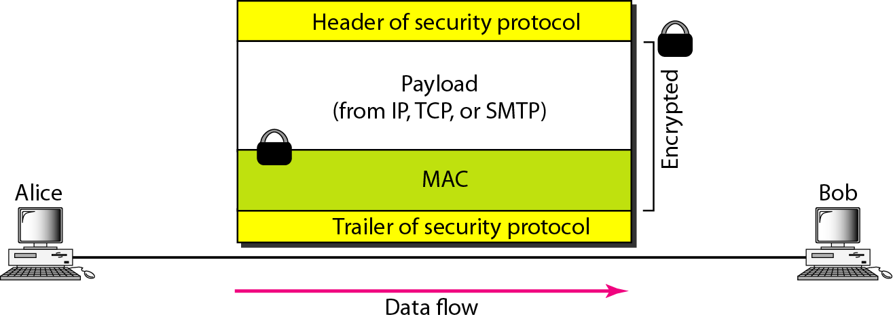
Common structure of three security protocols
Certain security aspects, particularly privacy and message authentication, can be applied to the network, transport, and application layers of the Internet model.
  IPSec protocol adds authentication and confidentiality to the IP protocol
  How SSL (or TLS) does the same for the TCP protocol
  How PGP does it for the SMTP protocol (e-mail)
Notes:
* Certain security aspects, particularly privacy and message authentication, can be applied to the network, transport, and application layers of the Internet model.
* IPSec protocol can add authentication and confidentiality to the IP protocol
* How SSL (or TLS) can do the same for the TCP protocol
* How PGP can do it for the SMTP protocol (e-mail)

Slide 3
IPSecurity (IPSec)
IPSecurity (IPSec) is a collection of protocols designed by the Internet Engineering Task Force (IETF) to provide security for a packet at the network level.
Topics discussed in this section:
Two Modes
Two Security Protocols
Security Association
Internet Key Exchange (IKE)
Virtual Private Network

Slide 4
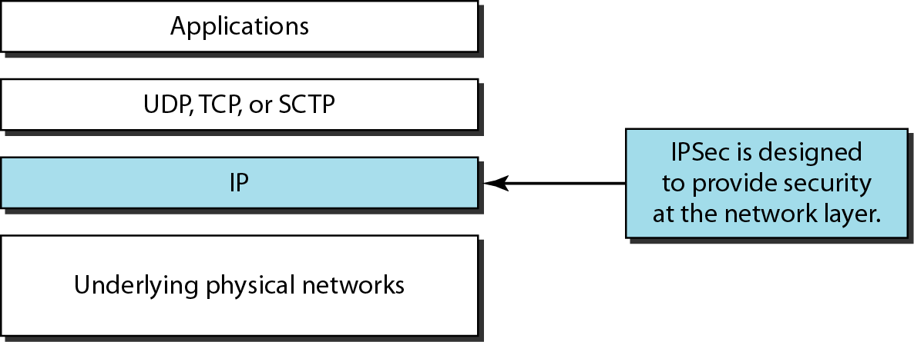
TCP/IP protocol suite and IPSec
IPSec helps to create authenticated and confidential packets for the IP layer.

Slide 5
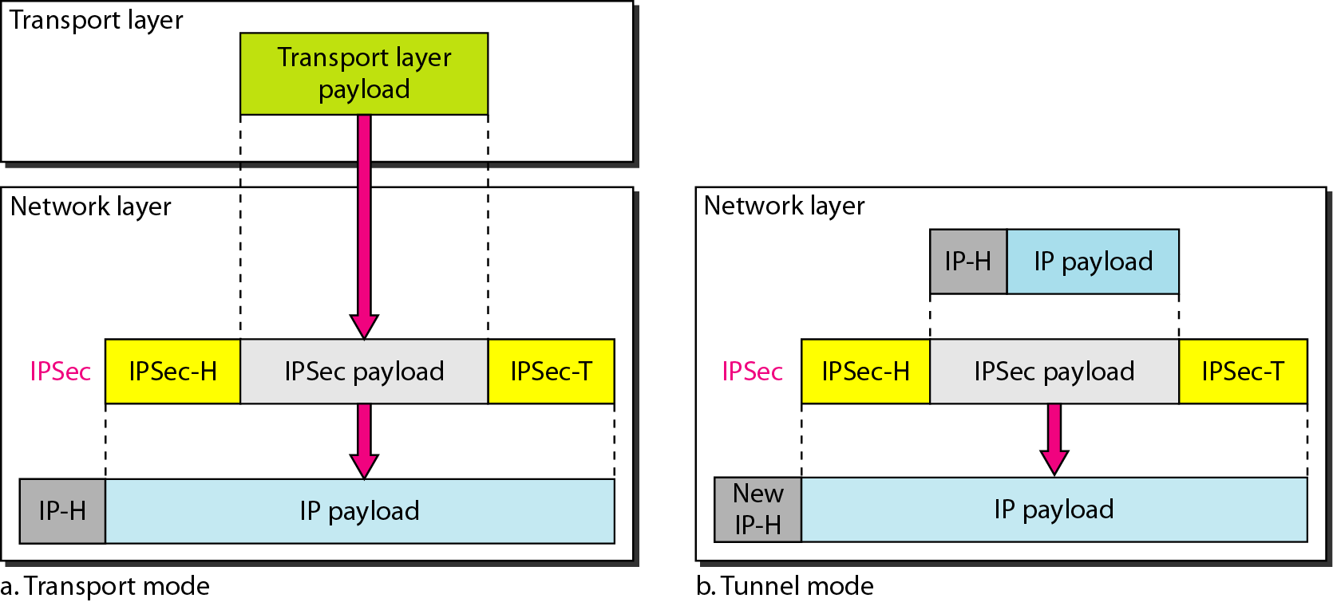
Transport mode and tunnel modes of IPSec protocol

Slide 6
Transport mode
IPSec does not protect the IP header; it only protects the information coming from the transport layer.
Normally used when we need host-to-host (end-to-end) protection of data
The sending host uses IPSec to authenticate and/or encrypt the payload delivered from the transport layer.

Slide 7
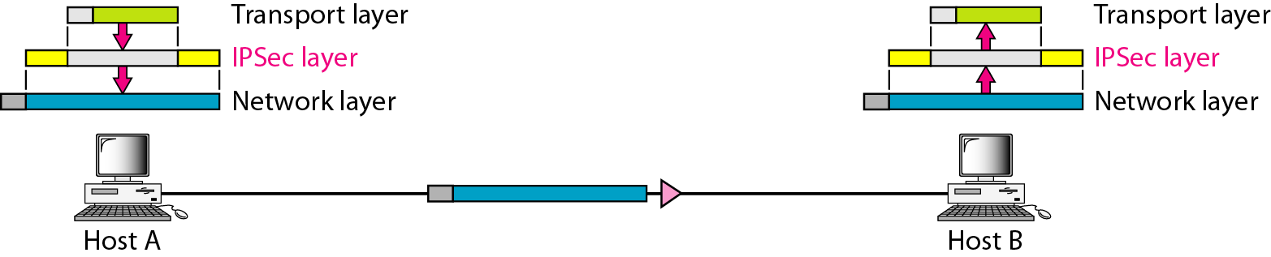
Transport mode in action

Slide 8
Tunnel mode
IPSec protects the entire IP packet including the original IP header.
IPSec adds a new IP header, which has different information than the original IP header
Normally used when either the sender or the receiver is not a host (e.g., router)

Slide 9
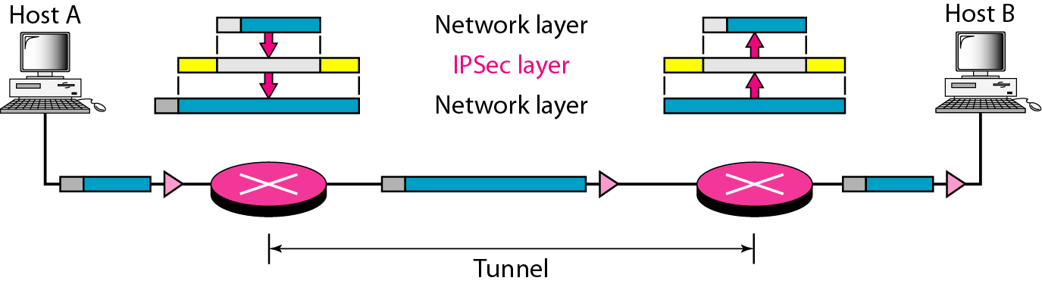
Tunnel mode in action

Slide 10
Two Security Protocols
IPSec defines two protocols:
  The Authentication Header (AH) Protocol
  The Encapsulating Security Payload (ESP) Protocol
Used to provide authentication and/or encryption for packets at the IP level.

Slide 11
Authentication Header (AH) Protocol in transport mode
AH protocol provides source authentication and data integrity (of the payload), but not privacy.
AH uses a hash function and a symmetric key to create a message digest
The digest is inserted in the authentication header, and the AH is placed in the packet based on the IPSec mode.

Slide 12
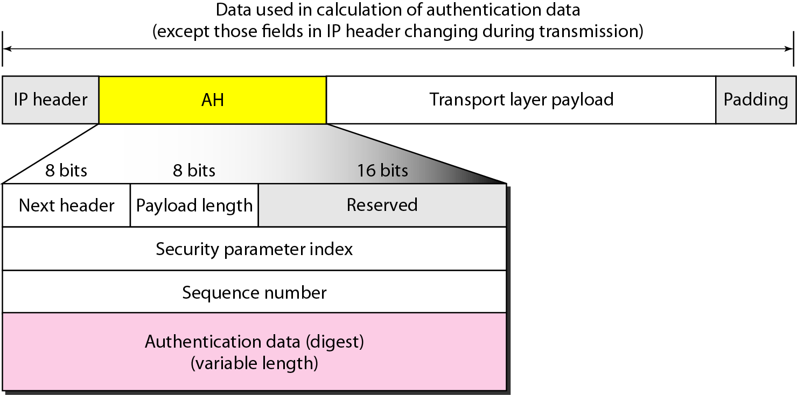
Authentication Header (AH) Protocol in transport mode
Notes:
ICV: Integrity Check Values : the Authentication Data (digest)
Fields INCLUDED in ICV calculation:
Source IP Address (4 bytes): 192.168.1.10
Destination IP Address (4 bytes): 192.168.1.20
IP Version (4 bits): 4
Internet Header Length (4 bits): 5
Type of Service (1 byte) - if not ECN/DSCP (depends on implementation)
Total Length (2 bytes): 69
Identification (2 bytes) - if DF=1 (not fragmented)
Flags (3 bits) - only high-order bit (reserved)
Fragment Offset (13 bits) - set to 0 if not fragmented
TTL (1 byte) - excluded! (mutable)
Protocol (1 byte) - set to original value (6) during calculation!
Header Checksum (2 bytes) - set to 0 during calculation
Important: During calculation, we use a special "pseudo-header" where:
Protocol field = Original value (6), not the actual value (51)
TTL = 0 (excluded)
Header Checksum = 0 (excluded)

Slide 13
Authentication Header (AH) Protocol in transport mode
Field Description
Next header (8-bit): defines the type of payload carried by the IP datagram (such as TCP, UDP, ICMP, or OSPF).
Payload length (8-bit): defines the length of the AH in 4-byte multiples, but it does not include the first 8 bytes.
Security parameter index (32-bit): plays the role of a virtual-circuit identifier and is the same for all packets sent during a connection called a Security Association (SA).
Sequence number (32-bit): provides ordering information for a sequence of datagrams.
  Prevents a playback.
  Is not repeated even if a packet is retransmitted.
  When SN reaches 232; a new connection must be established.
Authentication data: is the result of applying a hash function to the entire IP datagram except for the fields that are changed during transit (e.g., time-to-live),

Slide 14
Authentication Header (AH) Protocol in transport mode
The steps of adding an AH
An authentication header is added to the payload with the authentication data field set to zero.
Padding may be added to make the total length even for a particular hashing algorithm.
Hashing is based on the total packet. However, only those fields of the IP header that do not change during transmission are included in the calculation of the message digest (authentication data).
The authentication data are inserted in the authentication header.
The IP header is added after the value of the protocol field is changed to 51.

Slide 15
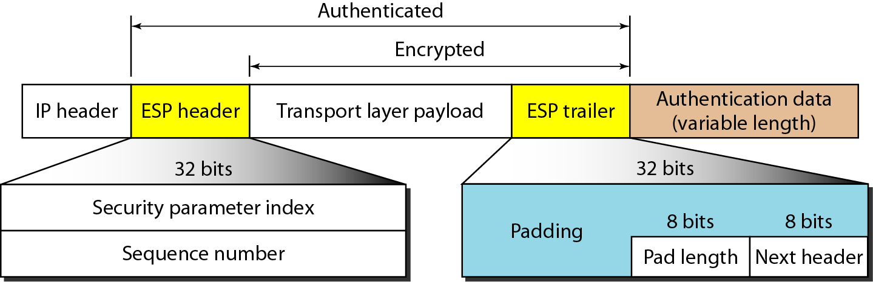
Encapsulating Security Payload (ESP) Protocol in transport mode

Slide 16
Encapsulating Security Payload (ESP) Protocol in transport mode
ESP provides source authentication, data integrity, and privacy.
ESP's authentication data are added at the end of the packet which makes its calculation easier
In AH, part of the IP header is included in the calculation of the authentication data; in ESP, it is not.
ESP does NOT authenticate the IP header at all.

Slide 17
Encapsulating Security Payload (ESP) Protocol in transport mode
The ESP procedure follows these steps
An ESP trailer is added to the payload.
The payload and the trailer are encrypted.
The ESP header is added.
The ESP header, payload, and ESP trailer are used to create the authentication data.
The authentication data are added to the end of the ESP trailer.
The IP header is added after the protocol value is changed to 50.

Slide 18
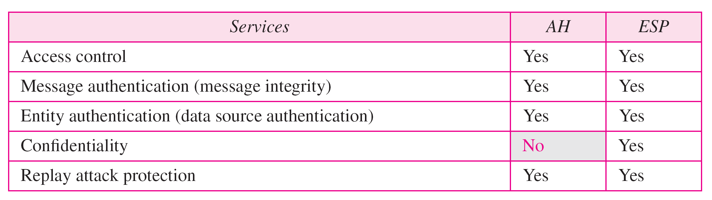
IPSec services

Slide 19
IPSec Services
Access Control: by using a Security Association Database (SADB). When a packet arrives at a destination, and there is no security association already established for this packet, the packet is discarded.
Message Authentication: The integrity of the message is preserved in both AH and ESP by using authentication data.
Entity Authentication: The security association and the keyed-hashed digest of the data sent by the sender authenticate the sender of the data in both AH and ESP.
Confidentiality The encryption of the message in ESP provides confidentiality.

Slide 20
IPSec Services
Replay Attack Protection In both protocols, the replay attack is prevented by using sequence numbers and a sliding receiver window
  Unique sequence number when the security association (SA) is established
  The number starts from 0 to 232 – 1.
  If sequence number = max =>
    Reset to zero,
    Old SA is deleted
    A new SA is established
To prevent processing of duplicate packets, IPSec mandates the use of a fixed-size window at the receiver (determined by the receive - default value of 64.)

Slide 21
Security Association (security association database (SADB))
Goal: establish a set of security parameters
like:
  Security Protocol (AH or ESP), SPI (Security Parameters Index), Encryption Algorithm (AES-CBC, ChaCha20, 3DES), Integrity / Authentication Algorithm (HMAC-SHA-1), Keying Material, Sequence Number State, Mode of Operation, Lifetime…
  Methods:
  Security parameters related to each datagram can be included in each datagram.
  A set of security parameters can be established for each datagram.
  A set of security parameters can be established between a sender and a particular receiver the first time the sender has a datagram to send.
IPSec changes a connectionless protocol, IP, to a connection-oriented protocol
This SA can be used all the time (unless a new one is established)

Slide 22
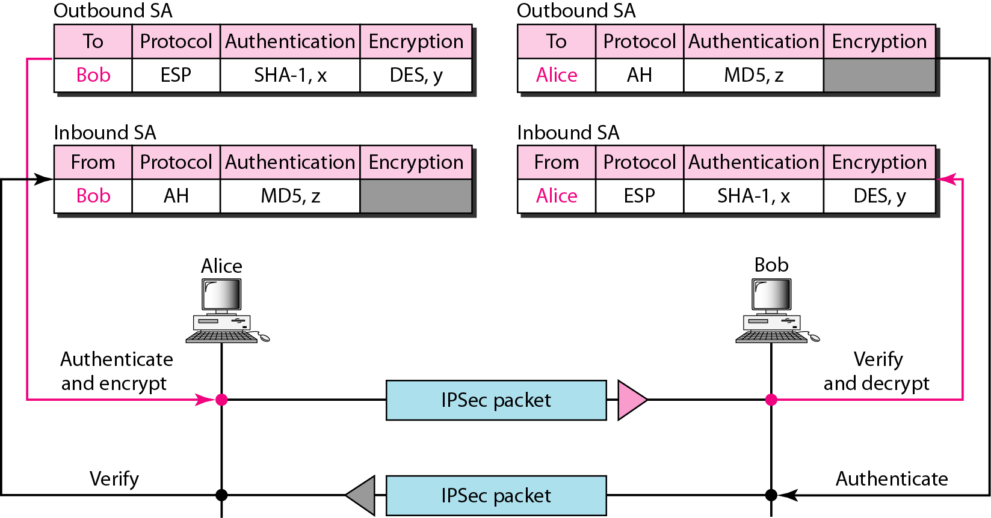
Simple inbound and outbound security associations

Slide 23
Internet Key Exchange (IKE)
IKE protocol creates SAs for IPSec in the SADB.
Uses 3 protocols: Oakley, SKEME and ISAKMP
Notes:
IKE: Internet Key Exchange.

Slide 24
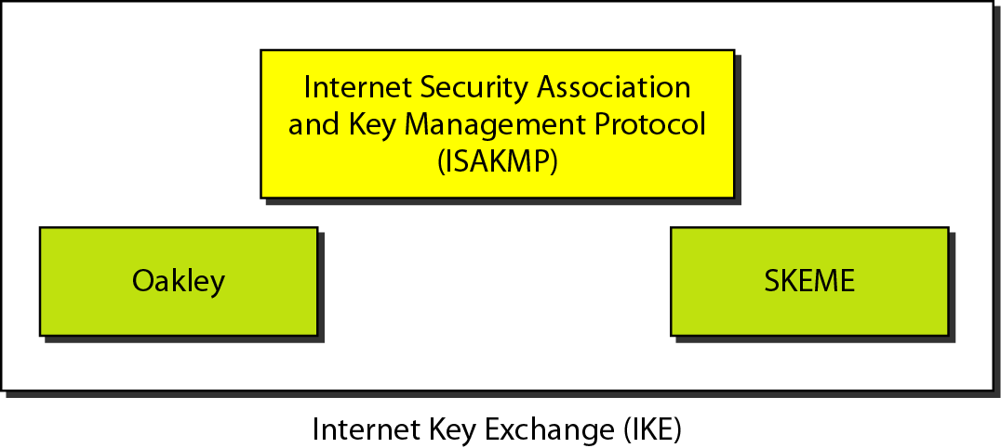
IKE components
Oakley Protocol
Developed by Hilarie Orman
Based on the Diffie-Hellman key-exchange method
SKEME Protocol
  Designed by Hugo Krawcyzk,
  Uses public-key encryption for entity authentication in a key-exchange protocol.
ISAKMP Protocol
  Developed by the National Security Agency (NSA)
  Allows the IKE exchanges to take place in standardized, formatted messages to create SAs

Slide 25
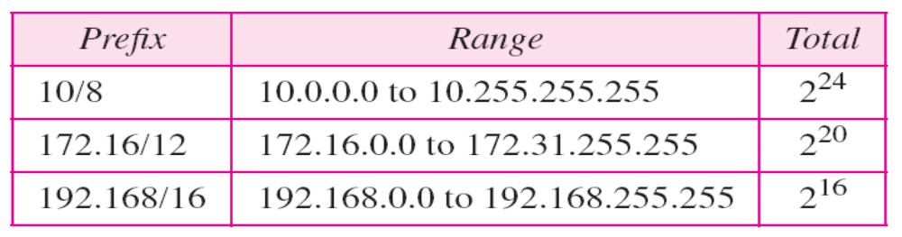
Virtual Private Network (VPN)
Goal: allows access to shared resources and, at the same time, provides privacy
Intranet / extranet
Addressing:
  Select addresses from Internet authorities.
  Create addresses without register them at the Internet authorities
  Use the reserved IP addresses

Slide 26
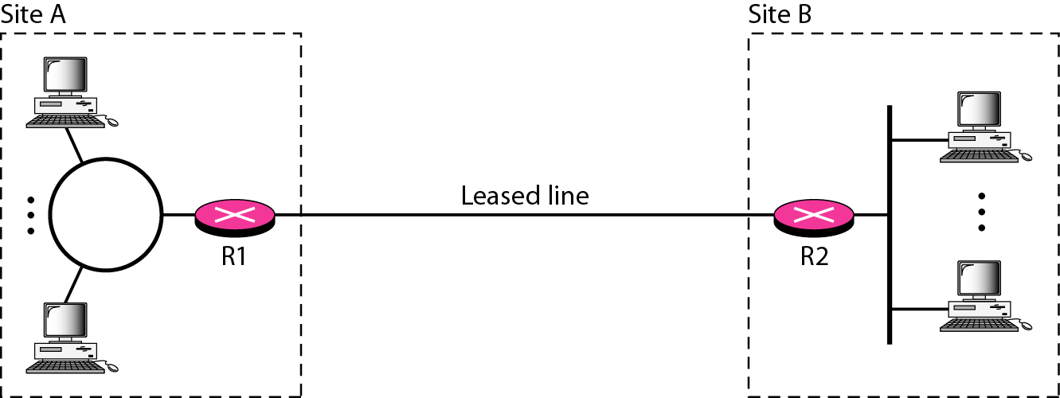
Private network

Slide 27
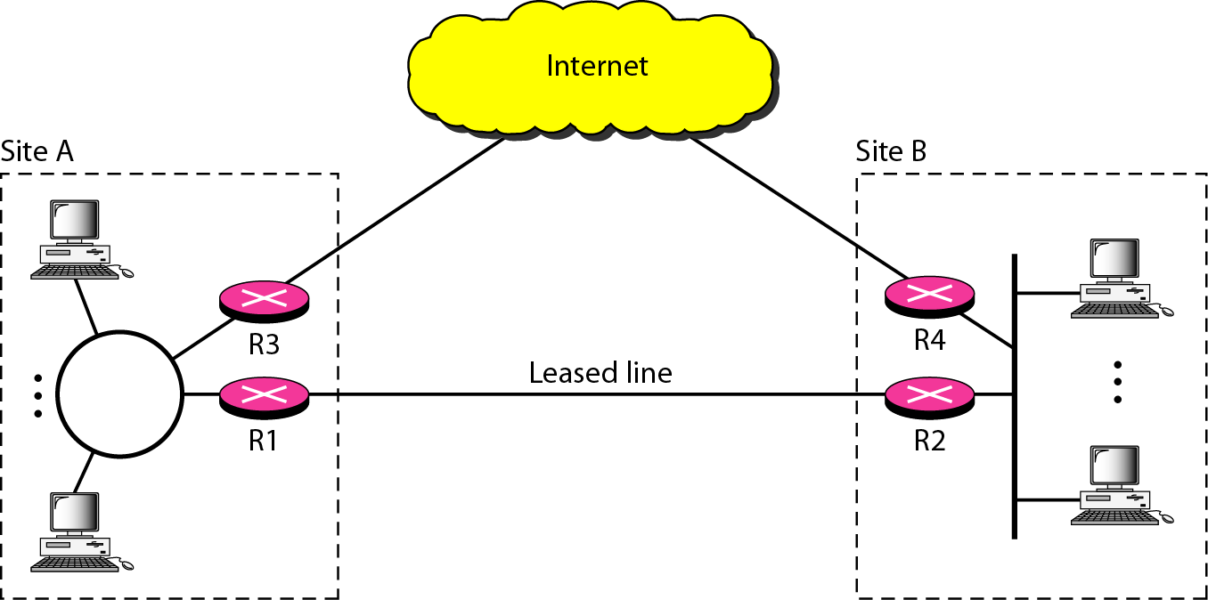
Hybrid network

Slide 28
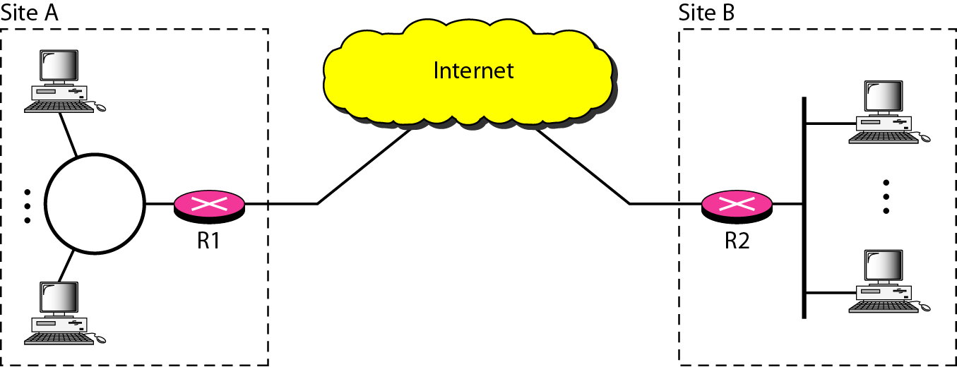
Virtual private network
It is virtual because it does not use real private WANs
The network is physically public but virtually private

Slide 29
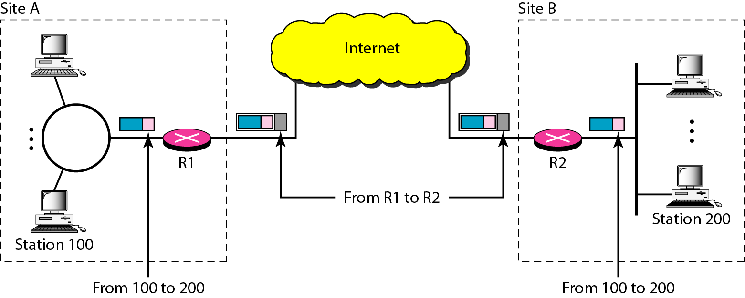
Addressing in a VPN
VPN technology uses IPSec in the tunnel mode to provide authentication, integrity, and privacy.
Each IP datagram destined for private use in the organization is encapsulated in another datagram
The public network (Internet) is responsible for carrying the packet from Rl to R2
Outsiders cannot decipher the contents of the packet or the source and destination addresses

Slide 30
SSL/TLS
Two protocols are dominant today for providing security at the transport layer: the Secure Sockets Layer (SSL) Protocol and the Transport Layer Security (TLS) Protocol.
Topics discussed in this section:
SSL Services
Security Parameters
Sessions and Connections
Four Protocols
Transport Layer Security

Slide 31
SSL/TLS
Goal: provide end-to-end security services for applications that use a reliable transport layer protocol such as TCP.
For example: when a customer shops online, the following security services are desired:
The customer and the vendor need to authenticate each other (customer is not an imposter, not sharing credit card number) – (entity authentication)
The customer and the vendor need to be sure that the contents of the message are not modified during transition (message integrity).
The customer and the vendor need to be sure that an imposter does not intercept sensitive information such as a credit card number (confidentiality).

Slide 32
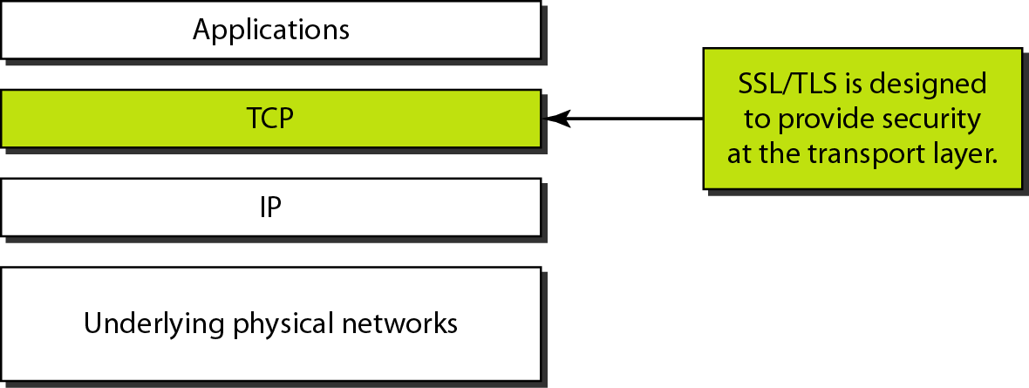
Location of SSL and TLS in the Internet model
Goal: designed to provide security and compression services to data generated from the application layer.
Receives data from any application layer protocol,
Usually, the protocol is HTTP
The application data are compressed (optional), signed, and encrypted
Then passed to a reliable transport layer protocol such as TCP
Developed by Netscape in 1994
Version 1, 2, and 3

Slide 33
Secure Socket Layer (SSL) Services
Fragmentation
First, SSL divides the data into blocks of 214 bytes or less.
Compression
Each fragment of data is compressed by using one of the lossless compression methods negotiated between the client and server (optional).
Message Integrity
SSL uses a keyed-hash function to create a MAC.
Confidentiality
The original data and the MAC are encrypted using symmetric key cryptography.
Framing
A header is added to the encrypted payload. The ,payload is then passed to a reliable transport layer protocol.

Slide 34
Secure Socket Layer (SSL) Security Parameters
Cipher suites and Cryptographic secrets
The combination of key exchange, hash, and encryption algorithms defines a cipher suite for each SSL session.
General Format:
SSL_key-exchange-algo_WITH_encryption-algo_hash-algo
Example: SSL_DHE_RSA_WITH_DES_CBC_SHA
Key exchange: DHE_RSA
Encryption algorithm: DES_CBC
Hash algorithm: SHA
Note: DH is fixed Diffie-Hellman, DHE is ephemeral Diffie-Hellman, and DH-anon is anonymous Diffie-Hellman.

Slide 35
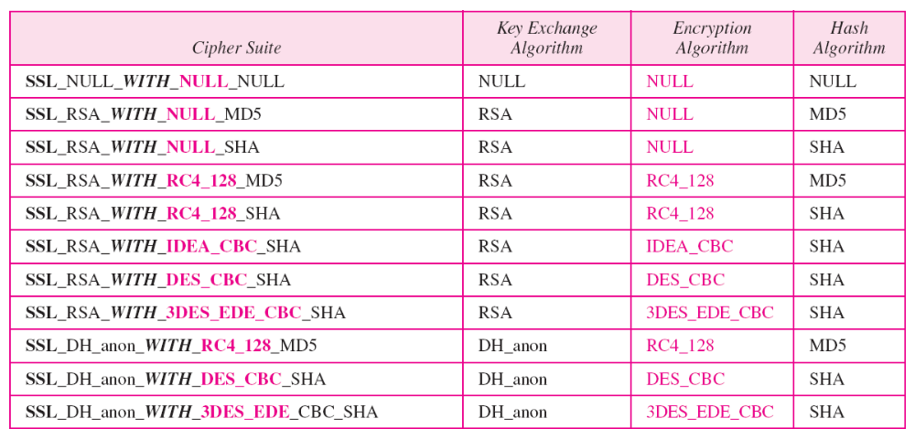
SSL cipher suite list

Slide 36
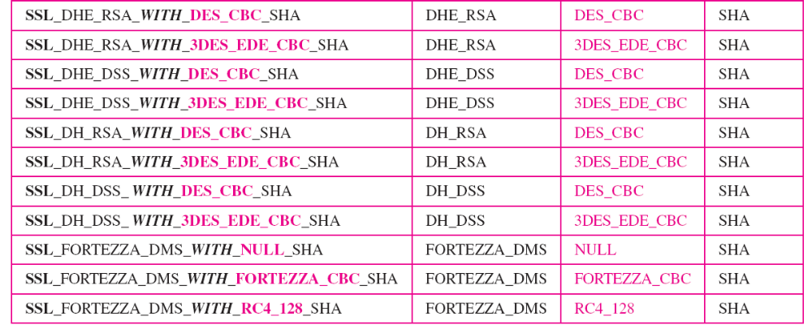
SSL cipher suite list (continued)
Notes:
CBC: Cypher Block Chaining

Slide 37
Secure Socket Layer (SSL) Security Parameters
Cipher suites and Cryptographic secrets
To achieve message integrity and confidentiality, SSL needs six cryptographic secrets: four keys, and two IVs.
The client and the server need
One key for message authentication,
One key for encryption,
One IV for block encryption.
Each direction requires different keys (prevents that an attack does not affect the other direction)
These parameters are generated by using a negotiation protocol
Notes:
IV: Initial Vector

Slide 38
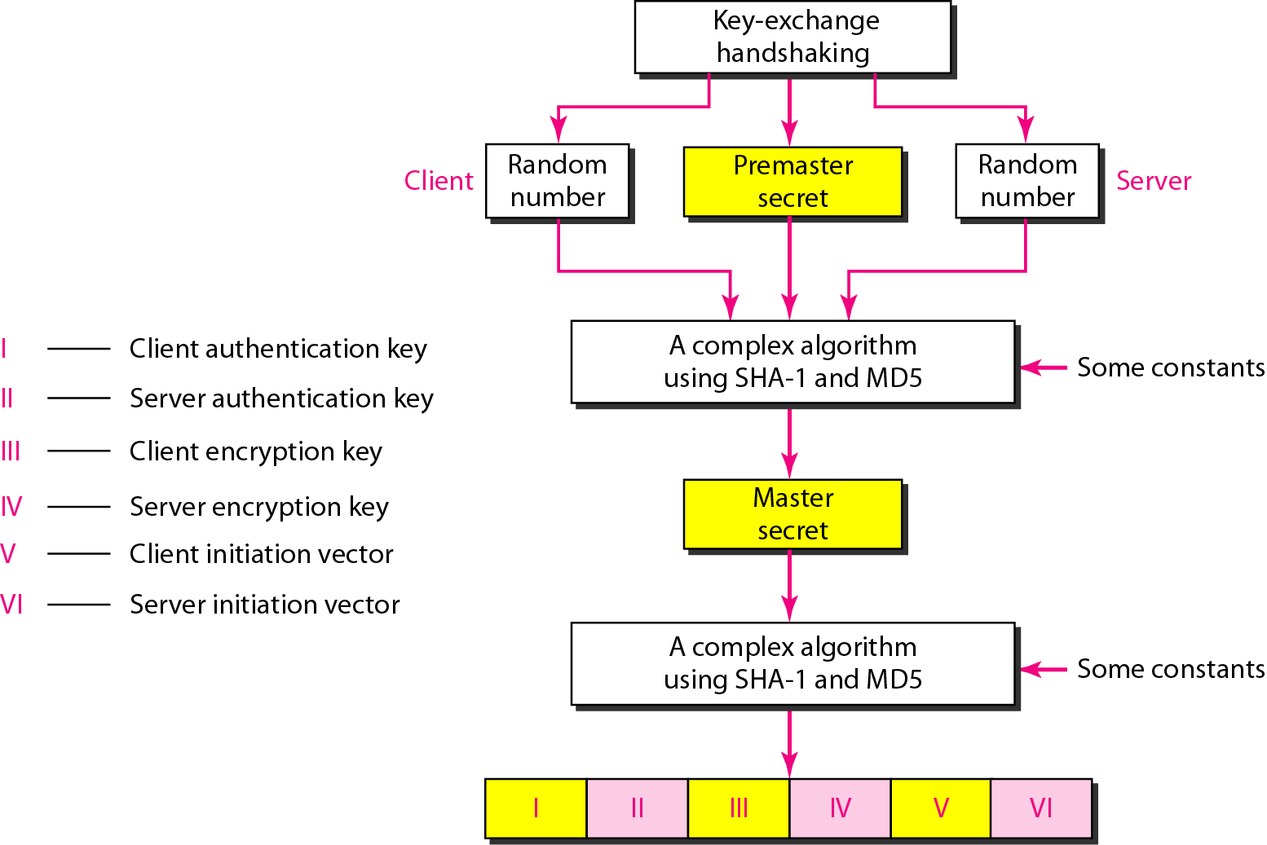
Creation of cryptographic secrets in SSL
1- client and server exchange two random numbers
2- client and server exchange one premaster secret by using one of the key exchange algorithms
3- A 48-byte master secret is created from the premaster secret
4. The master secret is used to create variable-length secrets

Slide 39
Sessions and Connections
IP is a connectionless protocol; TCP is a connection-oriented protocol
Association in IPSec transforms the connectionless IP to a connection-oriented secured protocol
Session: association that can last for a long time.
  Some of the security parameters are created during the session establishment and are in effect until the session is terminated (e.g. cipher suite and master key).
Connection: established and broken several times during a session.
  Some of the security parameters must be recreated (or occasionally resumed) for each connection (e.g. six secrets).
  SSL defines four protocols in two layers.

Slide 40
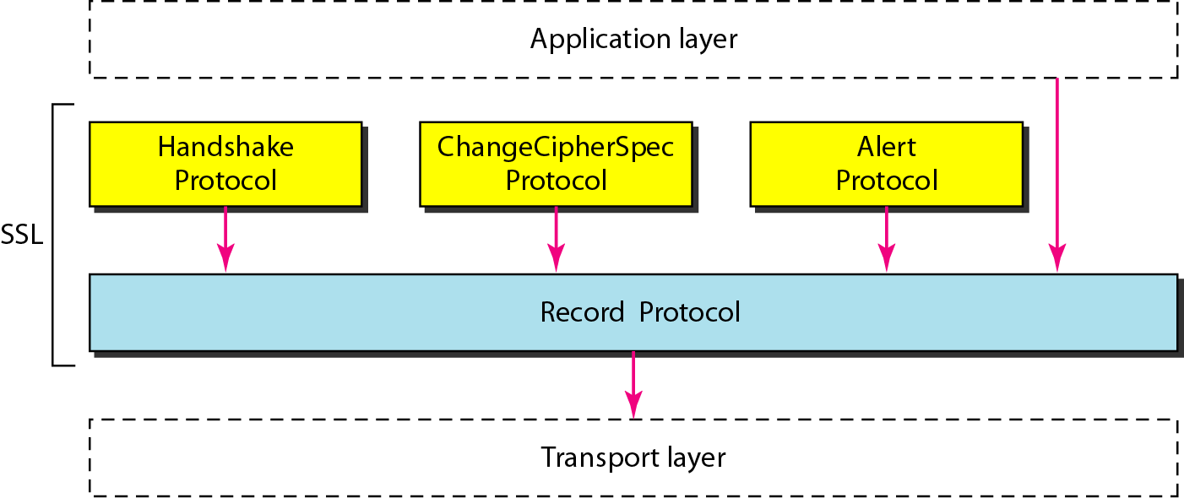
Four SSL protocols

Slide 41
Four SSL protocols
The Carrier: carries messages from three other protocols as well as the data coming from the application layer.

Slide 42
Four SSL protocols
Provides security parameters for the Record Protocol
Establishes a cipher set and provides keys and security parameters
authenticates the server to the client and the client to the server, if needed

Slide 43
Four SSL protocols
Signaling the readiness of cryptographic secrets
Special message sent before parties can use the parameters and secrets

Slide 44
Four SSL protocols
Report abnormal conditions
The alert message describes the problem and its level (warning or fatal)

Slide 45
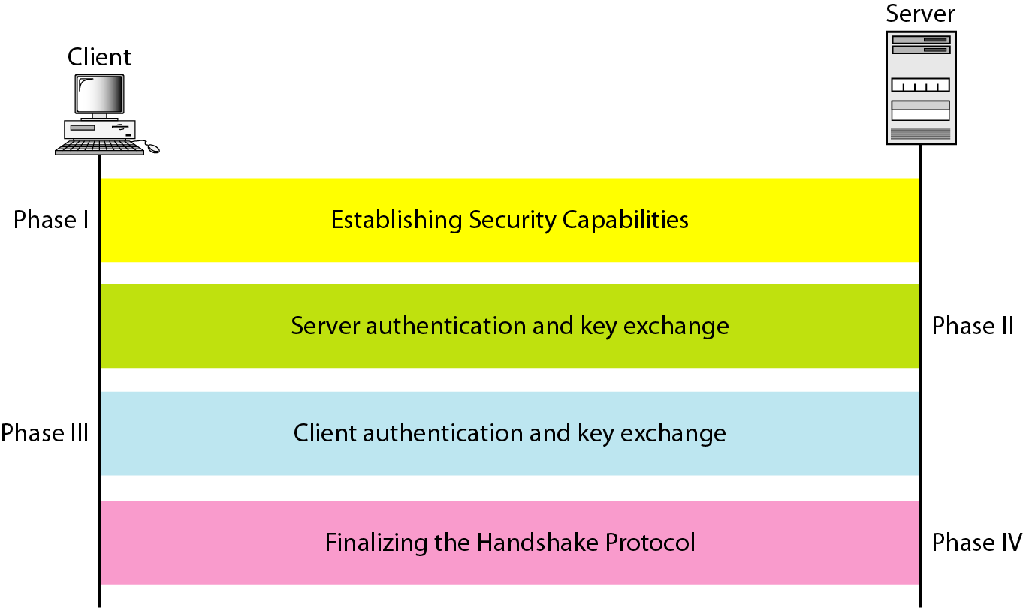
Handshake Protocol

Slide 46
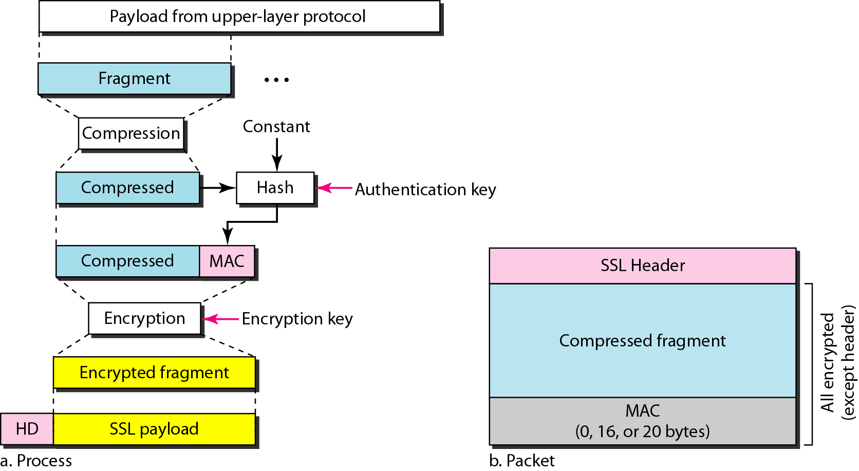
Processing done by the Record Protocol
Negotiated Algorithms

Slide 47
Transport Layer Security (TLS)
IETF standard version of SSL.
Differences:
SSLv3.0 discussed in this section is compatible with TLSv1.0.
TLS cipher suite does not support Fortezza.
TLS uses a pseudorandom function (PRF) to create the master key and the key materials for the cryptographic secrets
TLS deletes some alert messages and adds some new ones.
TLS changes details of some messages in Handshake protocol.
TLS uses HMAC instead of MAC in the Record protocol.

Slide 48
PGP
One of the protocols to provide security at the application layer is Pretty Good Privacy (PGP). PGP is designed to create authenticated and confidential
e-mails.
Topics discussed in this section:
Security Parameters
Services
A Scenario
PGP Algorithms
Key Rings
PGP Certificates

Slide 49
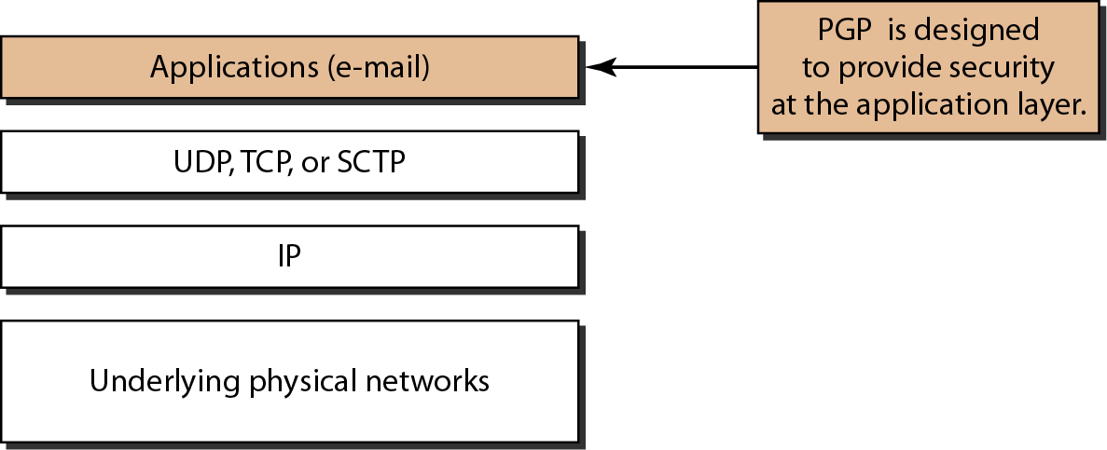
Position of PGP in the TCP/IP protocol suite

Slide 50
Pretty Good Privacy (PGP)
Sending an e-mail is a one-time activity (Alice sends a message to Bob; sometime later, Bob reads the message and may or may not send a reply)
In e-mail, there is no session and no handshake. To negotiate the algorithms for encryption and authentication.
=> security of a unidirectional message
Solution: the sender of the message includes the identifiers of the algorithms used in the message as well as the values of the keys.

Slide 51
Pretty Good Privacy (PGP) / Services
Plaintext
Message Authentication
  Signature using Public/Private Keys
Compression
Confidentiality
  One Time Session Key
  The key is sent within the message, encrypted with the receiver public key.
Code Conversion
  In email only ASCII is used.
  PGP uses Radix 64 conversion
Segmentation

Slide 52
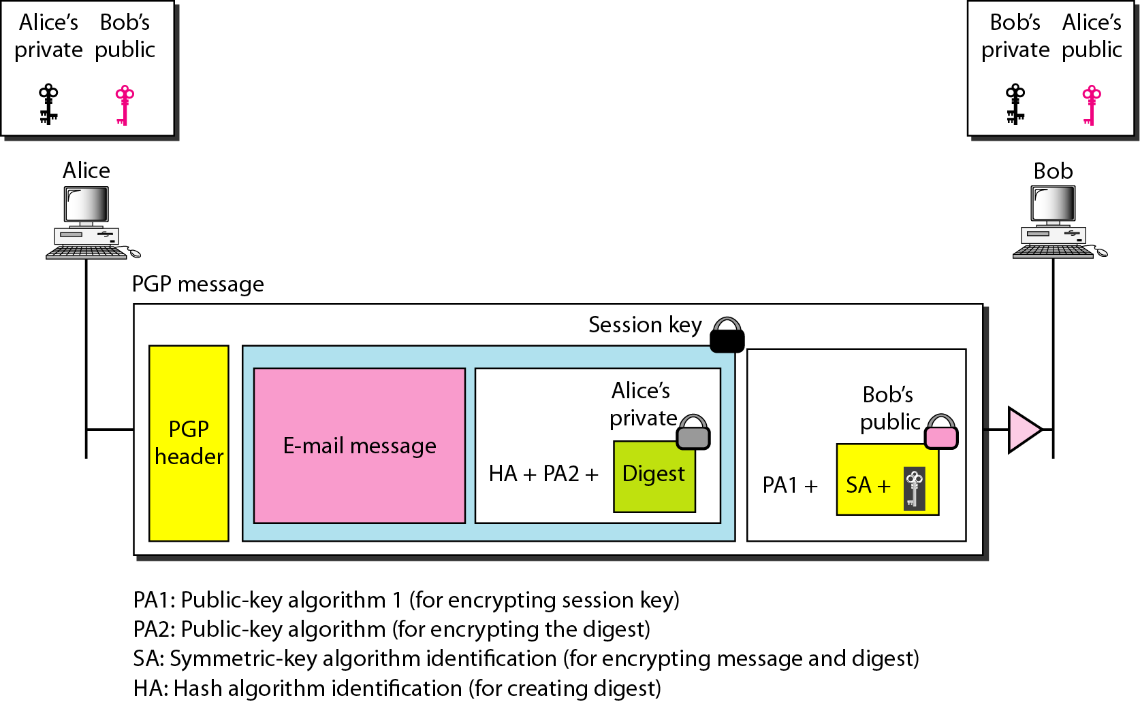
A scenario in which an e-mail message is authenticated and encrypted
1- Alice creates a session key (symmetric key) + SA
2- The result is encrypted with Bob's public key.
3- Adds the identification of the public-key algorithm
4- Signs the message (email)
5- Encrypts the whole thing, using the session key created in step 1.
6- Adds the appropriate PGP header

Slide 53
A scenario in which an e-mail message is authenticated and encrypted
1- Bob uses his private key to decrypt [SA + Session Key]
2- Decrypts the rest of the PGP message using the session key
3- Decrypts the digest using Alice public key
4- Creates hash using the HA to authenticate the message, and after comparing the results Bob accepts or rejects the message.

Slide 54
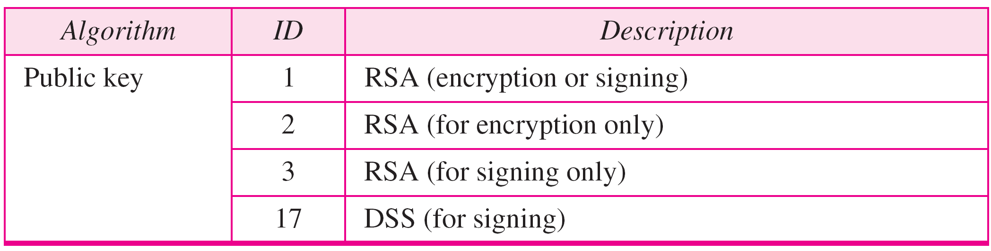
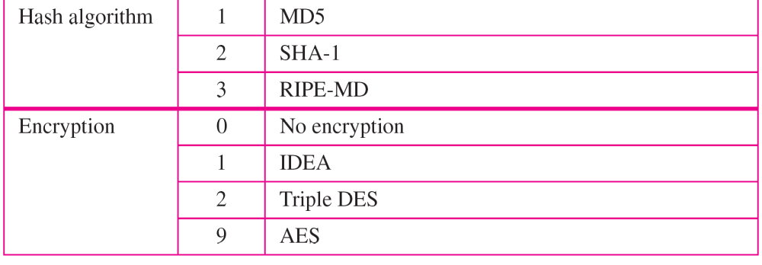
PGP Algorithms

Slide 55
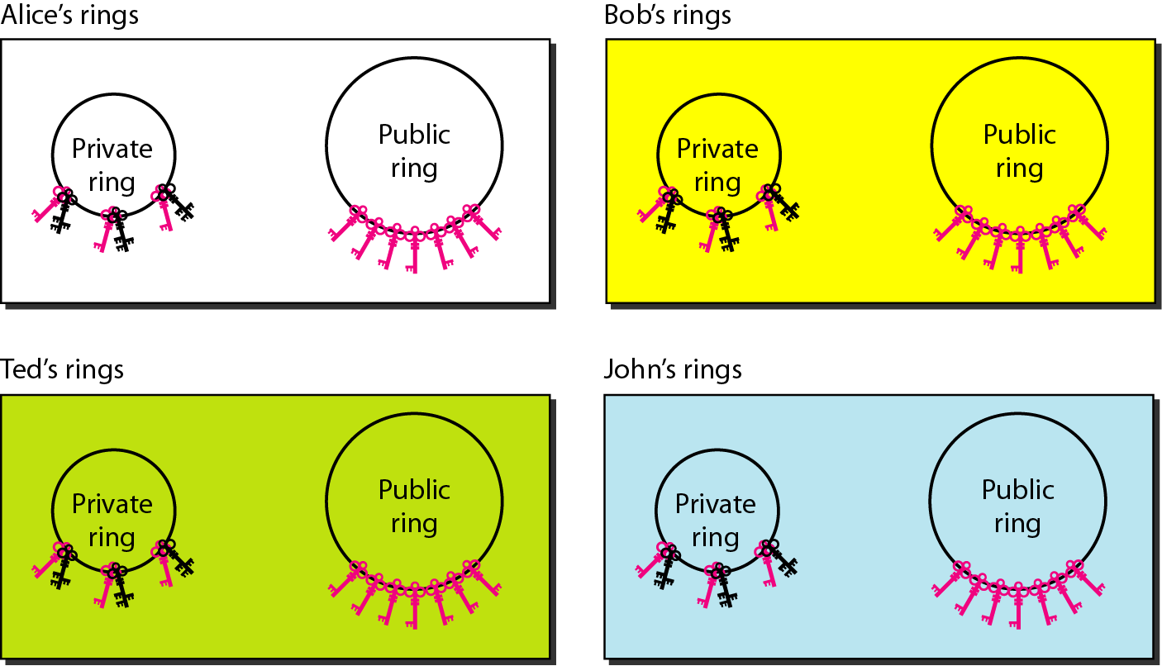
Rings

Slide 56
FIREWALLS
All previous security measures cannot prevent Eve from sending a harmful message to a system. To control access to a system, we need firewalls.
A firewall is a device installed between the internal network of an organization and the rest of the Internet. It is designed to forward some packets and filter (not forward) others.
Topics discussed in this section:
Packet-Filter Firewall
Proxy Firewall

Slide 57
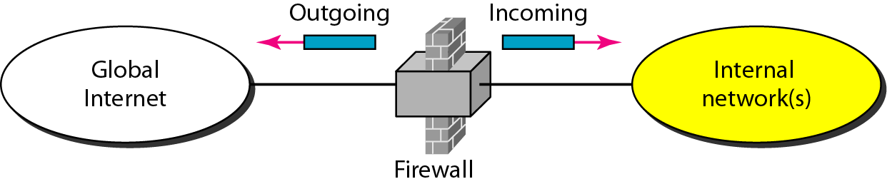
Firewall

Slide 58
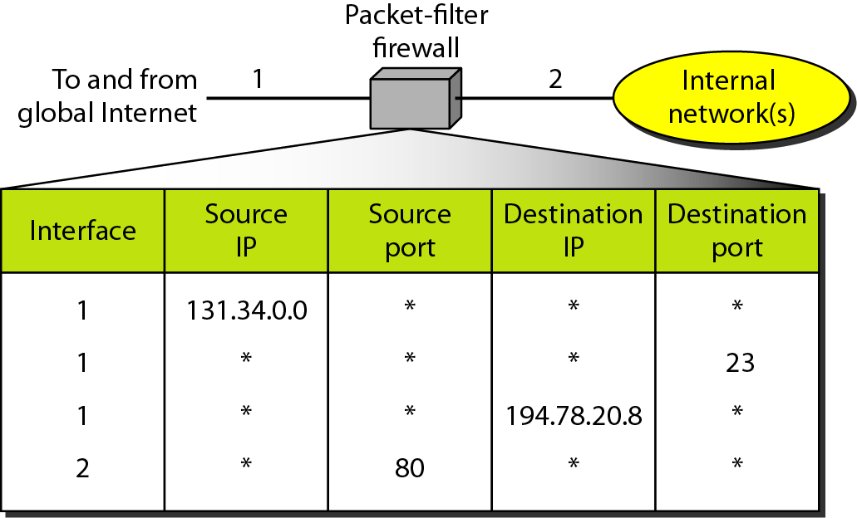
Packet-filter firewall

Slide 59
Packet-filter Firewall
A packet-filter firewall filters at the network or transport layer.
The packet-filter firewall is based on the information available in the network layer and transport layer headers
Sometimes we need to filter a message based on the information available in the message itself (at the application layer) => proxy firewall

Slide 60
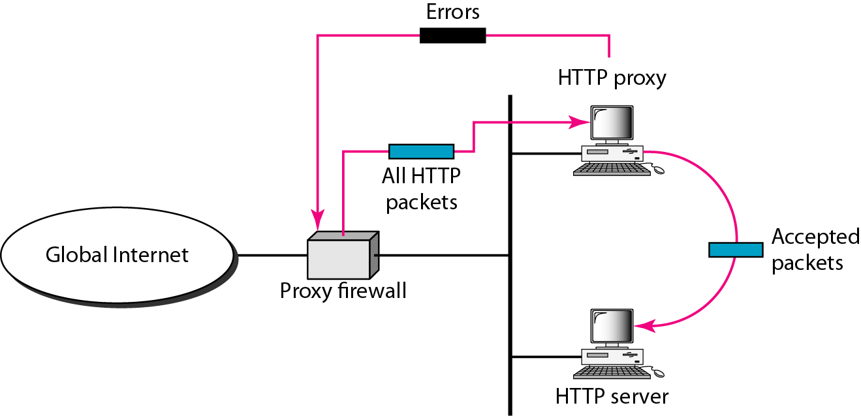
Proxy firewall
Policy: Only those Internet users who have previously established business relations with the company can have access; access to other users must be blocked.

